Slide 1
Delete
LabTI Universitas Gunadarma

Slide 2
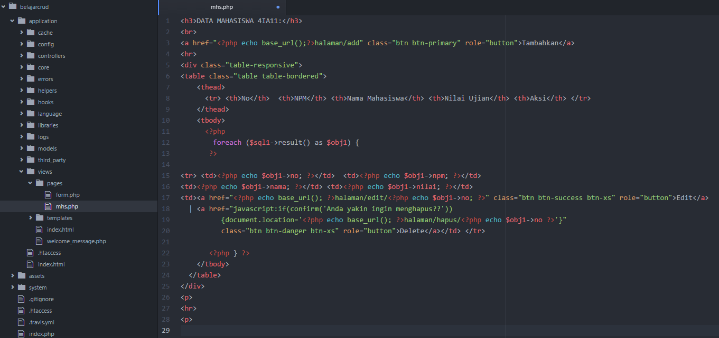
mhs.php

Slide 3
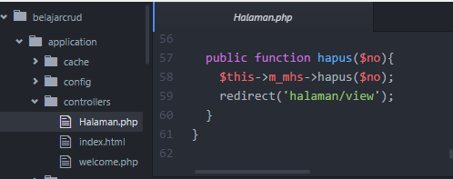
Controllers (halaman.php)

Slide 4
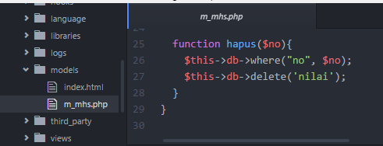
Models (m_mhs.php)

Slide 5
